Slide 1

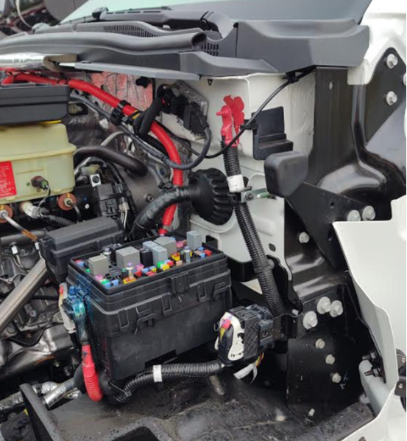
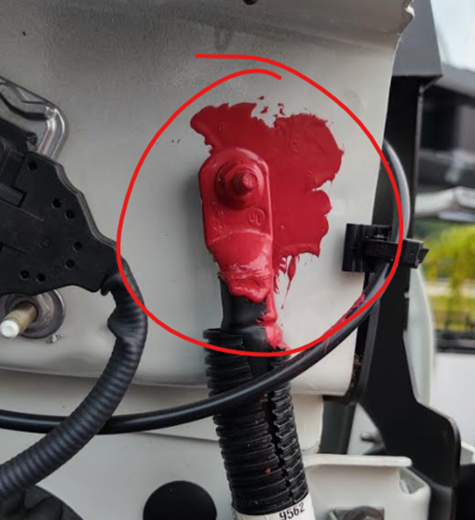
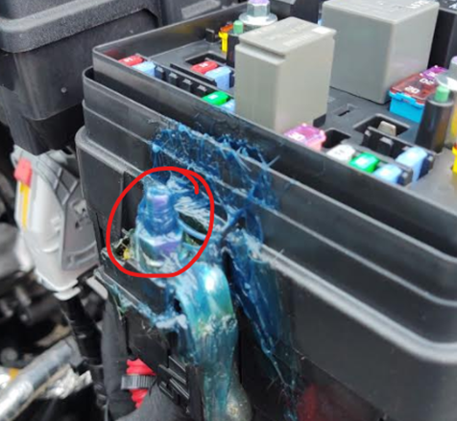
Jump Starting CV chassis
Service contacts – NeXus RV
844-348-6765
parts@nexusrv.com / warranty@nexusrv.com
In the unlikely event that the chassis AND house batteries are dead, and jumping house batteries to start the generator cannot be accomplished. International has equipped the CV (NeXus Rebel) with posts to jump start primary engine.
Positive
Negative

